Slide 1
Chapter 2 Neuroscience
Pastorino, What is Psychology? 4th Edition. © 2019 Cengage. All Rights Reserved. May not be scanned, copied or duplicated, or posted to a publicly accessible website, in whole or in part.

Slide 2
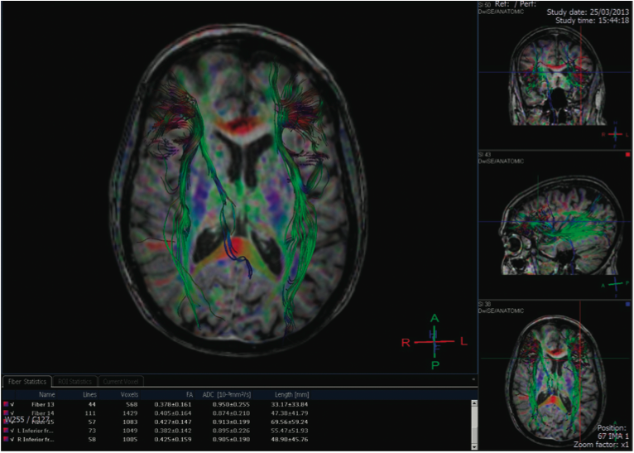
Neuroscience
Billions of Neurons: Communication in the Brain
Psychology Applies to Your World: Can Exposure to Wi-Fi Hotspots Affect the Brain?
Neurotransmitters and Neuromodulators: Chemical Messengers in the Brain
The Structure of the Nervous System
The Brain and Spine: The Central Nervous System
Technologies for Studying the Brain
The Endocrine System: Hormones and Behavior
Integrating Psychology: The Big Picture
Notes:
The discipline of neuroscience has a very simple question with a very complex task. It seeks to understand the relationship between our behaviors and mental functions and the functions of the brain and nervous system. If you go back to the definition of psychology from Chapter 1, you’ll find that neuroscience is a more specific approach to the study of psychology.

Slide 3
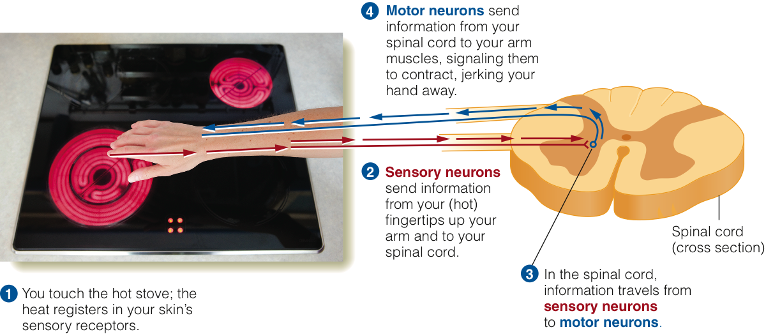
What Are Neurons and Why Are They Important?
The Neurons Involved in a Reflex
Notes:
The most basic unit of communication in the nervous system is the neuron. It transmits information so that different parts of the system can stay in touch with other parts. It helps us sense the world around us and initiate movement and, in many cases, is crucial for the automatic processes that take place in your body without you having any control over them.
Neurons are an important part of the system, but so too are glia cells. They support and nourish neurons, aid in neural signaling, and help the system to build and extend new neural networks. Myelin, a protective sheath that surrounds parts of neurons, is made of a form of glia cells.
Review what happens when myelin cells break down, as in the case of multiple sclerosis.

Slide 4
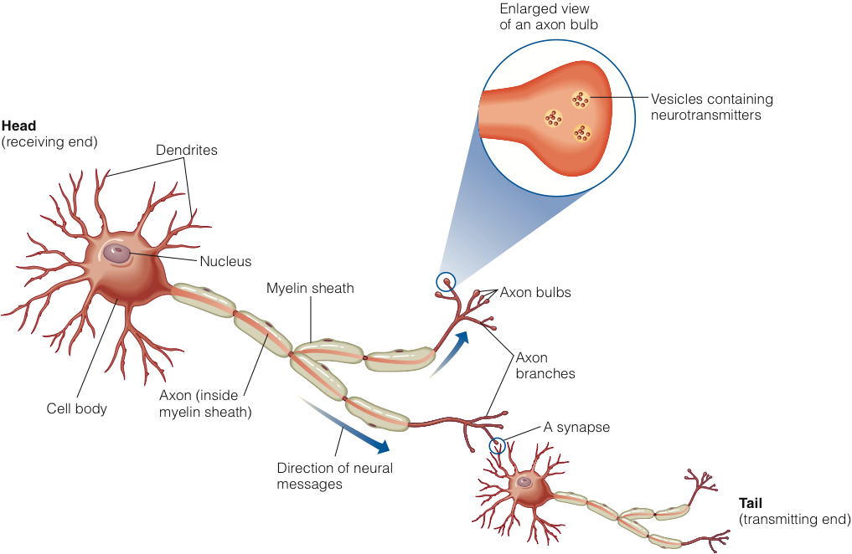
The Anatomy of the Neuron (1 of 2)
A Typical Neuron
Notes:
In order to understand how neurons work, you must first be familiar with the basic parts, or structures, of a neuron. See how your authors describe the following parts of a neuron:
- cell body
- dendrites
- axon
- myelin sheath
- axon bulb and vesicles
- neurotransmitters
- synapse (and synaptic gap)

Slide 5
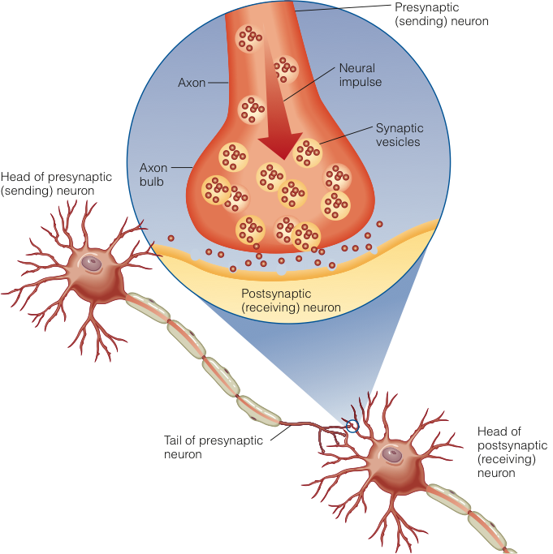
The Anatomy of the Neuron (2 of 2)
Detail of a Synapse
Notes:
It is important to remember that neurons don’t touch each other; they are separated by a microscopic space called the synaptic gap. This space has a number of other names too.
It will be important for you to understand how communication takes place within a single neuron and how that differs from the communication that occurs between two neurons.

Slide 6
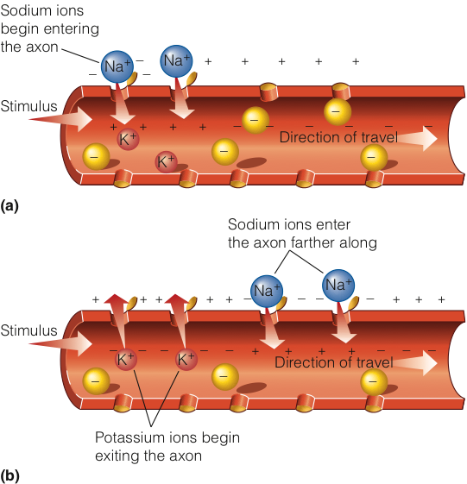
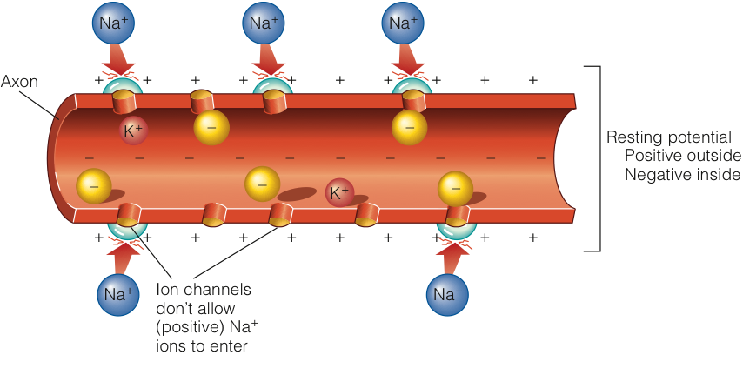
Signals in the Brain: How Neurons Fire Up
Resting Potential
Action Potential
Notes:
The most important thing for you to understand is that within a neuron, communication is electrical in nature, but between two neurons, communication is chemical.
The electrical potentials of a neuron are made possible by the presence of positive and negative ions. During the neuron’s inactive state (or resting potential), negative ions are more concentrated inside the neuron’s membrane, and the neuron has a negative charge. The opposite is true during the active state (or action potential) when a neuron is “firing.” This reversal occurs when the neuron is adequately stimulated and excides its threshold for excitation. What does it mean to say that this occurs in an all-or-none fashion?

Slide 7
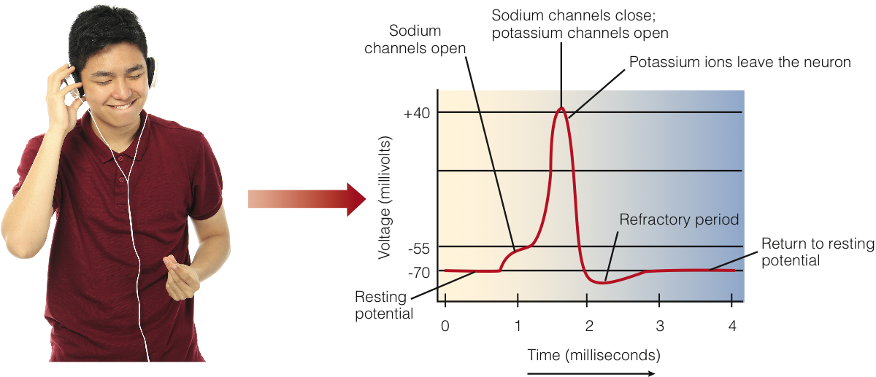
Returning to the Resting Potential: The Refractory Period
Electrical Changes in the Neuron as It Fires an Action Potential
Notes:
If you are using your computer and it starts to get errors, you may have to restart it. Annoying, right? After you tell the system to restart (or maybe just push the power button!), you have to wait for it to reset before you can use it. The neuron is sort of the same way. After it fires, or experiences an action potential, it must reset all the way back to a resting potential before it can fire again. This tiny amount of time when the neuron cannot fire (during the reset stage) is called a refractor period.

Slide 8
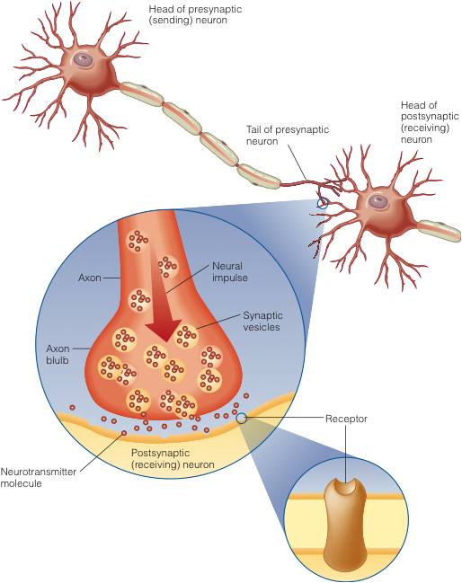
Jumping the Synapse: Synaptic Transmission
Neurotransmitters Carry the Signal Across the Synapse
Notes:
When you get to your home, maybe you need to put a key into the lock to open the door. Neurons work the same way. The keys are the neurotransmitters that must float across synaptic gaps and open up receptor sites on the surface of the next neuron. Just like with your door, the right key must slide into the right lock or nothing will happen.
Some of these keys act like the gas pedal of the car, producing an excitation effect. Others are like stepping on the brake, as they cause an inhibition effect.
After these neurotransmitters do their job, some are inevitably left behind in the synapse. They may be removed through reuptake or through enzymatic degradation so that the synapse is left squeaky clean for the process to repeat.

Slide 9

Neuromodulators and Acetylcholine
Notes:
Neurotransmitters are chemicals that send messages between neurons. Neuromodulators are similar, though they don’t change the way the resting potential of the postsynaptic cells functions.
Now we get to a discussion of several different types of neurotransmitters. Make sure that you review thoroughly how your text discusses each of them.
Acetylcholine (ACH) can function as both an inhibitory or excitatory neurotransmitter, but recent focus has been on its role in memory and consciousness. Research finds that there is a stunning relationship between ACH activity and Alzheimer’s disease, which is marked by progressive memory loss among other functional deteriorations.

Slide 10


Dopamine, Serotonin, and Norepinephrine: Deepening Our Understanding of Mental Illness
Notes:
You cannot study neurotransmitters without focusing on their role in mental illness; conversely, you cannot hope to understand mental illness without a strong comprehension of neurotransmitters.
A deficit of dopamine activity is believed to be a primary culprit in the neuromotor illness called Parkinson’s disease, which is also a form of dementia, or neurocognitive disorder. But dopamine levels that are too high appear to be related to the symptoms of schizophrenia, which involves a loss of contact with reality. Medications used to treat either illness must be given with care so that the other condition is not inadvertently induced.
Serotonin is a neurotransmitter with a variety of applications, including sleep, arousal, mood, eating, and pain perception. What medications might be prescribed that affect serotonin levels? What conditions are addressed by these drugs?
Norepinephrine (NOR) is another neurotransmitter that can also act as a hormone. It plays a role in sleep, arousal, and mood.
Do you see how there is overlap between the functions of different neurotransmitters?

Slide 11

Endorphins: Thank Goodness We Have Them!
Notes:
Have you ever broken a bone? Caught your hand in drawer or a door? Felt the beautiful release of pain associated with the “runner’s high” when on a long jog? Severe injury sometimes causes a sensation of numbness where you might expect pain. This is due to endorphins, which help to block pain messages from making it to the brain. While this can provide temporary relief, endorphins do not do their job for very long, so that broken bone is likely to start hurting after just a few moments.

Slide 12
Neurotransmitters
Neurotransmitter/ Neuromodulator | Functions | Related Diseases and Clinical Conditions
Acetylcholine | Excites skeletal muscles; inhibits heart action; memory | Alzheimer's disease
Dopamine | Movement; learning; attention; motivation and reward; social interaction | Parkinson's disease; schizophrenia; substance abuse
Serotonin | Sleep; arousal; mood; eating; pain perception | Depression; obsessive compulsive disorder and other anxiety disorders; eating disorders; chronic pain
Norepinephrine | Sleep; arousal; mood | Depression and other mood disorders
GABA | Chief inhibitor; regulates arousal; may play a role in pain perception | Some anxiety disorders; some seizure disorders; perhaps some chronic pain conditions
Glutamate | Chief excitatory neurotransmitter; many diverse functions | Neural death following head injuries
Endorphins (typically neuromodulators) | Suppression of pain; eating; cardiovascular functioning | Depression

Slide 13
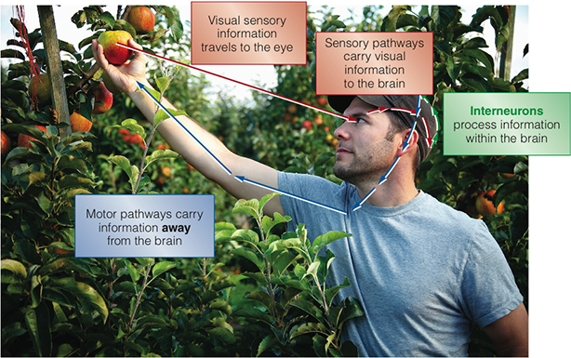
Sensing and Reacting: The Peripheral Nervous System
Sensory and Motor Pathways
Notes:
All nerves or neurons that are not contained in the brain or spinal cord comprise the peripheral nervous system, which is divided into two branches: the somatic and autonomic nervous systems.
The somatic nervous system is responsible for controlling voluntary motor activities, like using your pen to write down these notes.
The autonomic nervous system regulates glands, internal organs, and involuntary motor functions. Do you ever think about your heart beating or your digestive system’s processes? Probably not! These “automatic” processes are controlled by the autonomic nervous system.
Refer to your text for a discussion of the two divisions of the autonomic nervous system, which are the sympathetic (fight-or-flight) and parasympathetic (rest and digest) nervous systems.

Slide 14
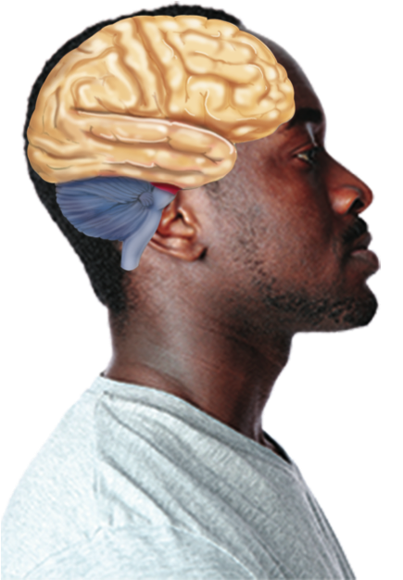
Your Central Processing Unit
The Human Hindbrain, Midbrain, and Forebrain
Notes:
The human brain has developed over the course of three distinct versions of itself. Brain 1.0 is the hindbrain.
Brain 2.0 is the midbrain.
Brain 3.0 is the forebrain.
What will Brain 4.0 look like? You won’t have to worry about it. Why? You won’t be around to see it!

Slide 15
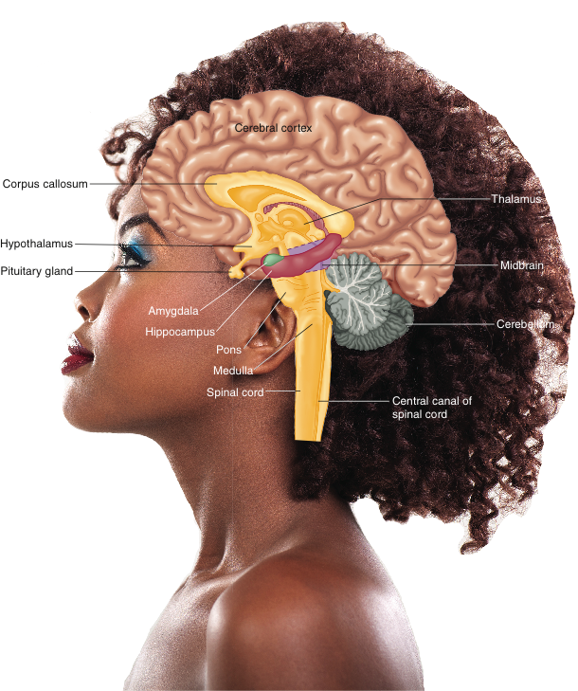
The Hindbrain and the Midbrain
The Brain and its Structures
Notes:
The hindbrain is our oldest level of brain and contains structures that are essential but that do not really distinguish us from other animals. So these areas control crucial but not advanced functions.
Refer to your text to understand the purposes of the hindbrain structures:
- the medulla
- the pons
- the cerebellum
How would damage or incorrect functioning of any of these structures affect your life?
The next level of brain tissue, the midbrain, contains the reticular formation. This structure acts as a bridge, of sorts, between lower and higher brain structures. It is involved in arousal, states of consciousness, cardiovascular and respiratory activity, and movement.

Slide 16
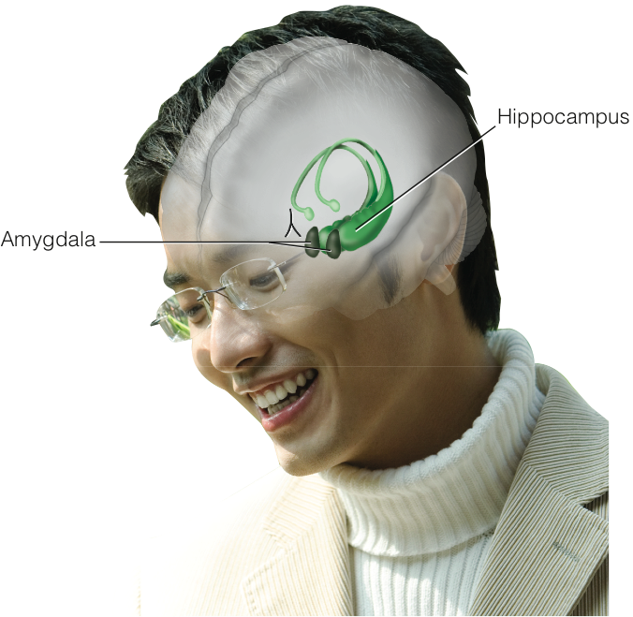
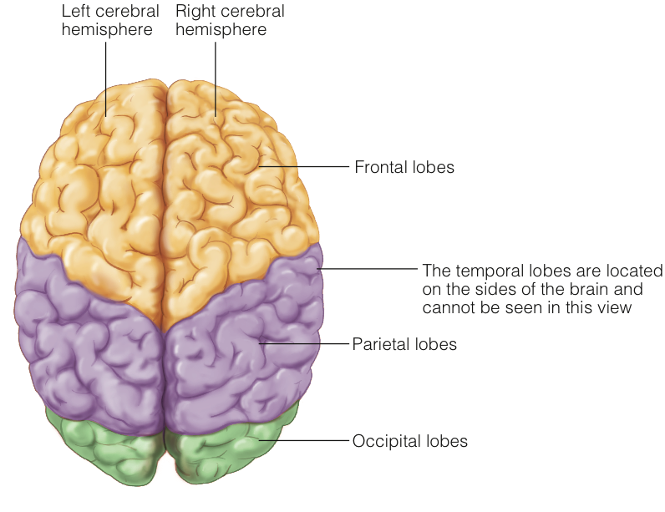
The Forebrain
The Cerebral Hemispheres
The Limbic System
Notes:
The forebrain is our most recent and most advanced level of brain tissue, and it contains many different structures:
- the limbic system (which includes the amygdala and hippocampus)
- the thalamus
- the hypothalamus
Each of these plays different roles in both psychological and physiological functioning. You may want to make some flashcards to help you remember which is which.
Also please remember that the brain is vastly more complicated than we are presenting here, and you are getting a very basic introduction to brain structures. You can study the brain for years before you will have an advanced understanding of its functions and its vast potential.

Slide 17
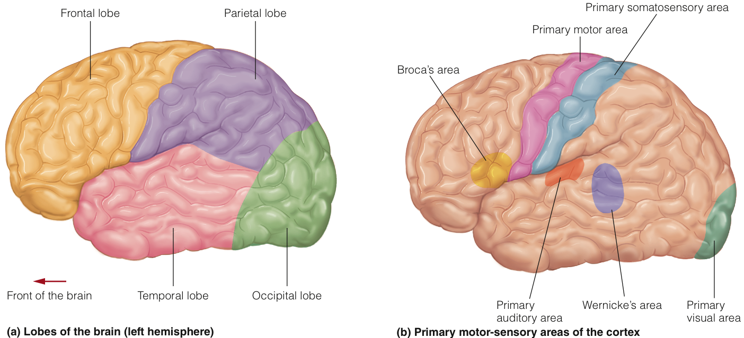
The Cortex
The Human Brain
Notes:
There is no such thing as an unimportant brain structure, but the cerebral cortex is the most advanced and proportionately the largest structure. It is so large that it is divided into two halves (or hemispheres) and four areas (called lobes). Make sure you are clear that this means there are eight total lobes (four on the left and four on the right).
The left and right hemispheres may each have more input into different functions—this is called lateralization—but avoid falling for the myth that people are either “right-brained” or “left-brained.”
Different lobes and their unique functions are described in the next slides.
The different functions of hemispheres can be seen in how language is handled. Broca’s area, in the left frontal lobe, is responsible for speech production. Wernicke’s area, in the left temporal lobe, however, is responsible for language comprehension. Can you see how very closely related functions are handled (a) in the same half of the brain, but (b) in different areas?
Do you think the brains of men and women are very different from each other? There are differences, mostly in the fact that women have slightly larger brains, thicker connections between hemispheres (the corpus callosum), and less lateralization. But the exact consequence of these differences is an area of intensive investigation.

Slide 18
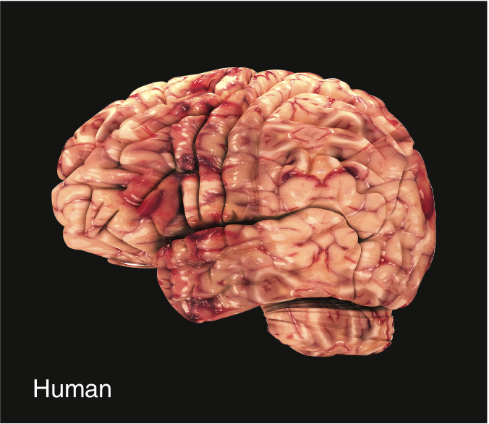
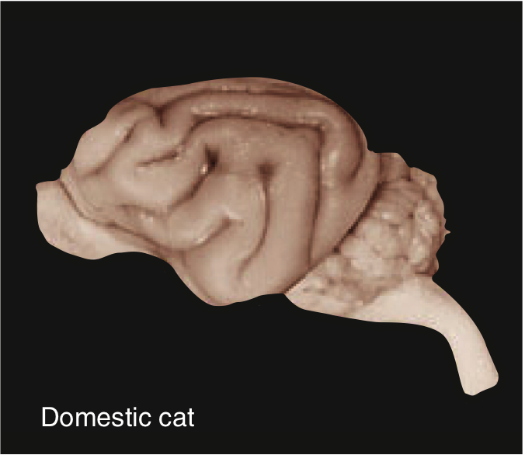
The Specialization of Function in the Lobes of the Cortex
Cortex of a Human Brain and a Cat Brain
Notes:
Once again, the brain is an extraordinarily complicated organ that takes extensive study to understand. A brief review of the lobes of the cortex would include the following:
1. Frontal Lobe—Association cortex, Broca’s area, cognitive processes, personality, and the motor cortex
2. Parietal Lobe—Association cortex, somatosensory cortex (touch, pressure, and pain)
3. Occipital Lobe—Visual cortex (primary visual area)
4. Temporal Lobe—Auditory cortex (primary auditory area)
Refer to your text to see how the brain changes as we age.

Slide 19
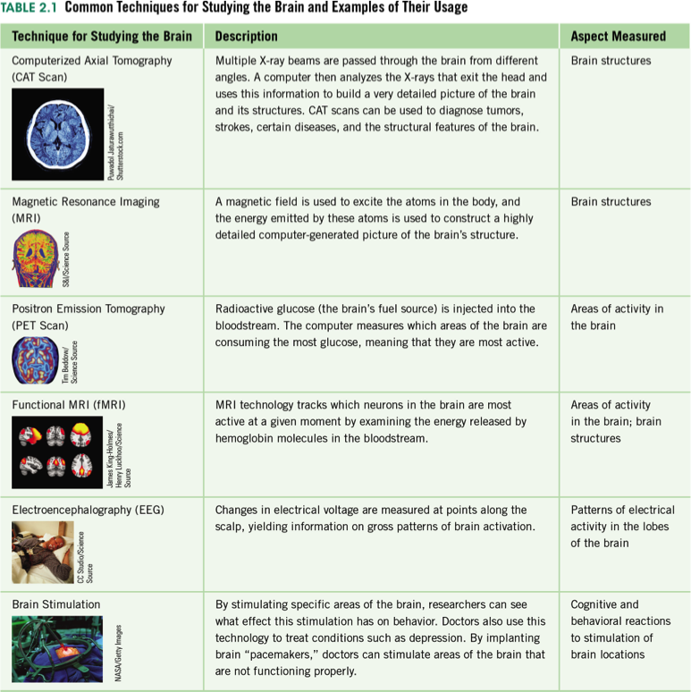
Common Techniques for Studying the Brain
Notes:
One of the great advancements in psychology, specifically the biological approach (including neuroscience), is in the technologies that have allowed us to understand the mechanical functions of the brain in ways never before possible. Study these different approaches, focusing on the different techniques and the advantages and drawbacks of each.

Slide 20
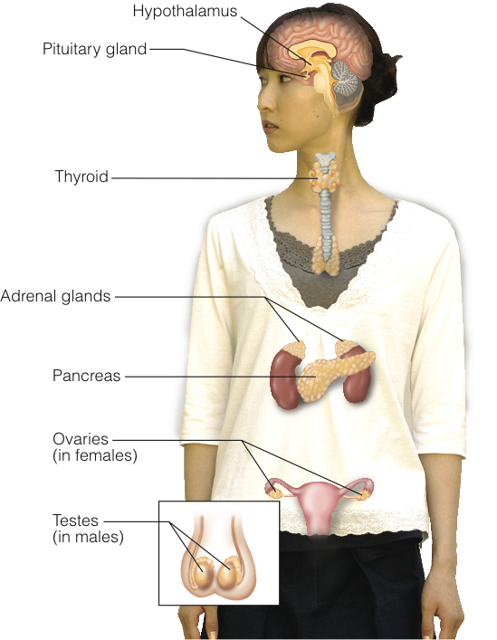
Chemicals That Travel to Go to Work!
Major Endocrine Glands of the Body
Notes:
Neurotransmitters do their job at the location where they are released. Hormones, on the other hand, are secreted by glands of the endocrine system and can travel via the bloodstream to affect other parts of the body.
The endocrine system is under the control of the hypothalamus, which in turn sends messages to the pituitary gland. This gland, sometimes described as the “master gland,” controls the other glands of the body.
Review carefully the glands and hormones of the endocrine system as well as their functions:
- Pituitary gland
- Gonads
- Adrenal glands
- Thyroid
- Pineal gland
- Pancreas

